Slide 1
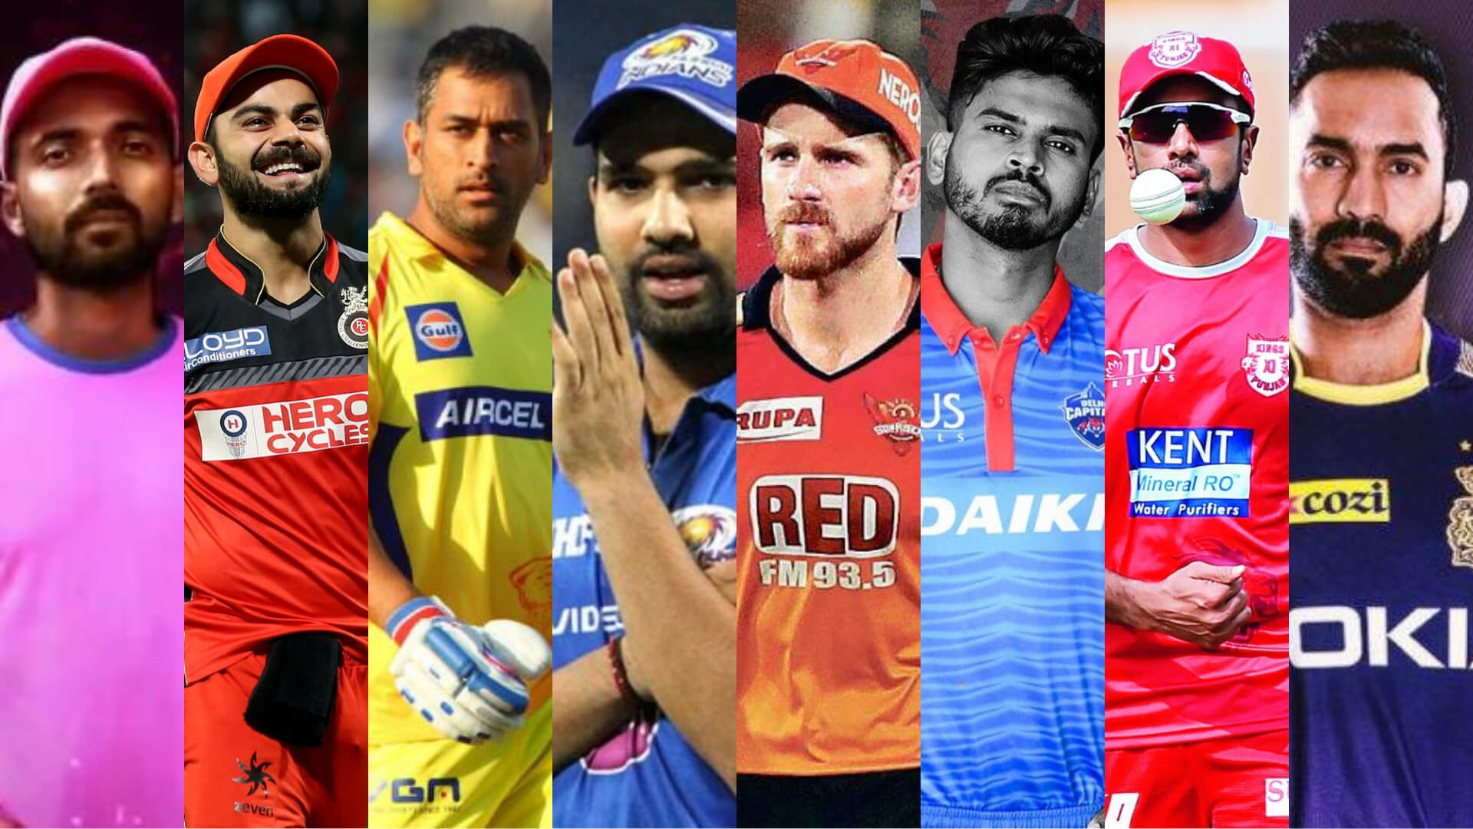
EDA of Indian Premier League
IPL 2008 to 2018

Slide 2
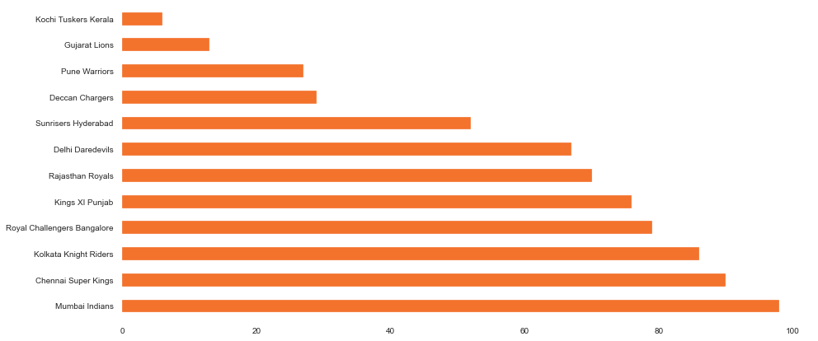
Which team has won the maximum matches played yet?
In the above graph, it’s clear that Mumbai Indians is leading here, followed by Chennai Super Kings.

Slide 3
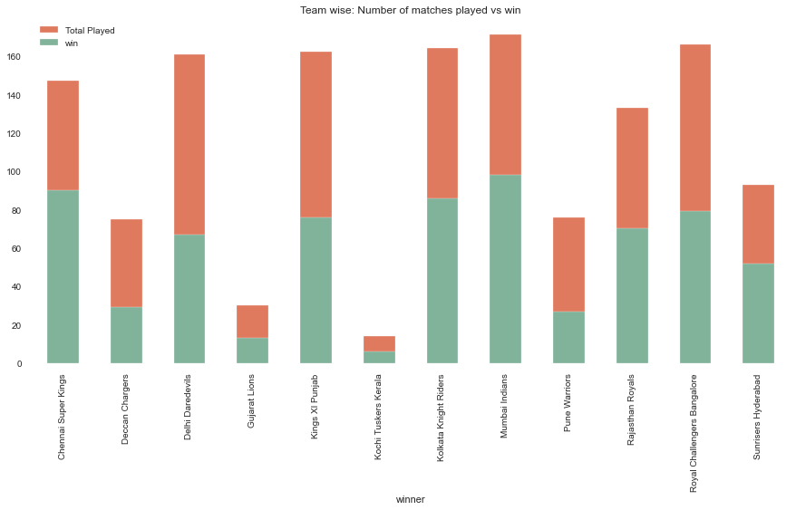
Team wise performance, Total matches played vs matches they won
The above graph shows, we can narrate that MI has played maximum games and also won maximum in the above list.

Slide 4
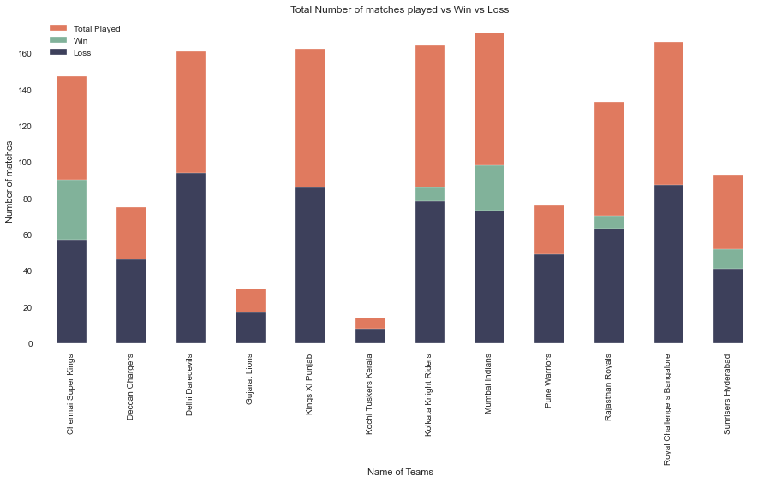
Team wise performance, Total matches played vs matches they won vs Lost
In the above graph we have added one more layer which is loss in the game, and MI is not leading here.

Slide 5
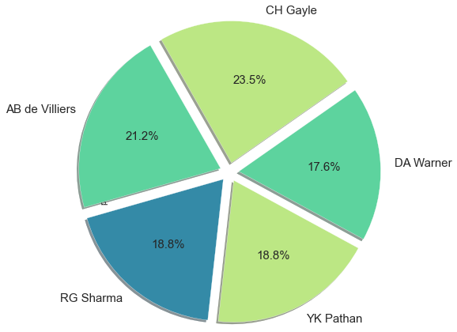
Which player won the maximum number of times the Player of the match title?
CH Gayle is a player of Royal Challengers Bangalore and leads in this list but in the winning graph, RCB lands at 4th position and MI at first.

Slide 6
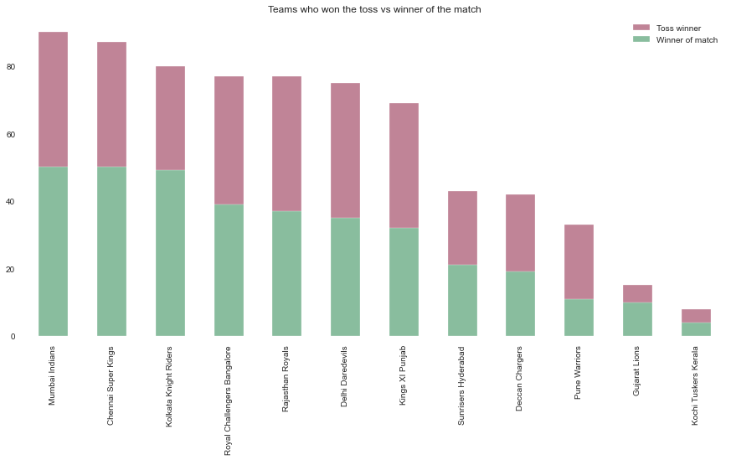
Does Toss makes any difference in the match result?
It’s very clear that toss plays a very vital role in winning the match whenever teams won the toss approx 50% times they win. So, if the team won the toss half battle is already conquered.

Slide 7
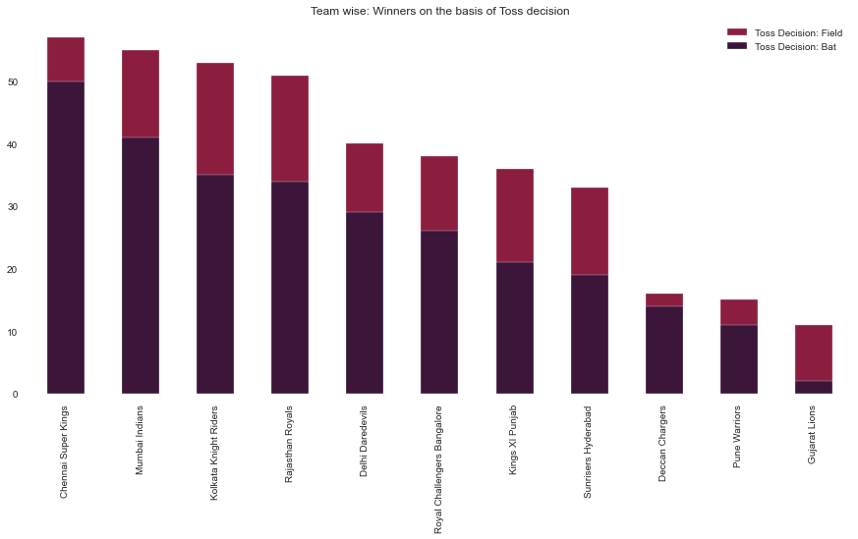
After winning toss what teams prefer to choose batting or fielding?
As the graph show, teams prefer to go for fielding first when they won the toss, as chasing the runs in this kind of format is easy.

Slide 8
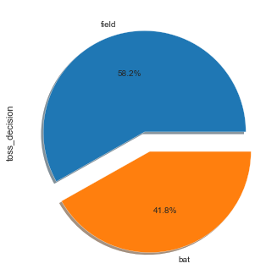
What contributes to winning for Mumbai Indians, fielding or batting
58.2% times MI won the match when they field first, which concluded two things, one is that their bowlers are so efficient that they don't give many runs or the batsmen played well and chase any target given by opponents.

Slide 9
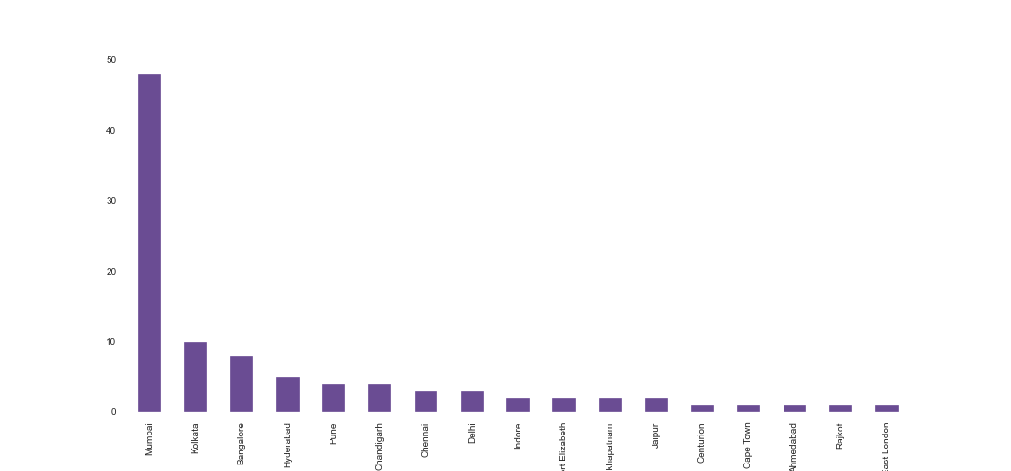
Does MI has Home advantage?
Yes, it is, see the straight line on the left, it tell the complete story.

